Slide 1
Robotic Arm DMP Project
Iobaj Andrei Sebastian & Moldovan Alexandru Cristian

Slide 2
Table of contents
01
02
03
04
05
06
Introduction
Planning
Preparation
What do we want to do?
How do we want to do it?
Getting the right tools
Implementation
Testing
References
Making it a reality
Does it work?
Our inspiration

Slide 3
01
Introduction
What is our project about?

Slide 4
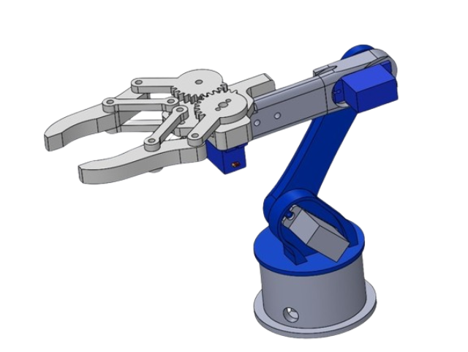
What to expect from the project?
We wanted to make a robotic arm!
The arm can be controlled through a phone application via Bluetooth.

Slide 5
02
Planning
How do we forge this into reality?

Slide 6
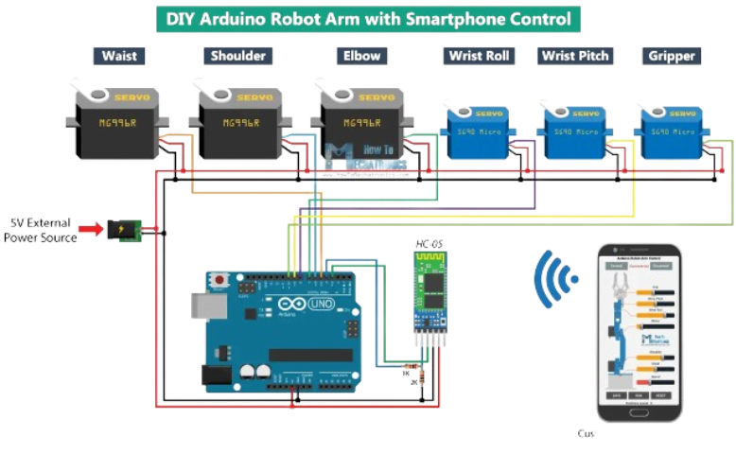
Planning Guide
We found a guide (link in References), that helped us get an idea of what had to be done:
Gave us an idea of what hardware components we need
Create a simple Arduino program to control servo motors
Gave us an idea of app design for our control app

Slide 7
03
Preparation
“We’re going hunting!” “For what?” “Weapons!”
Quote from Doctor House

Slide 8
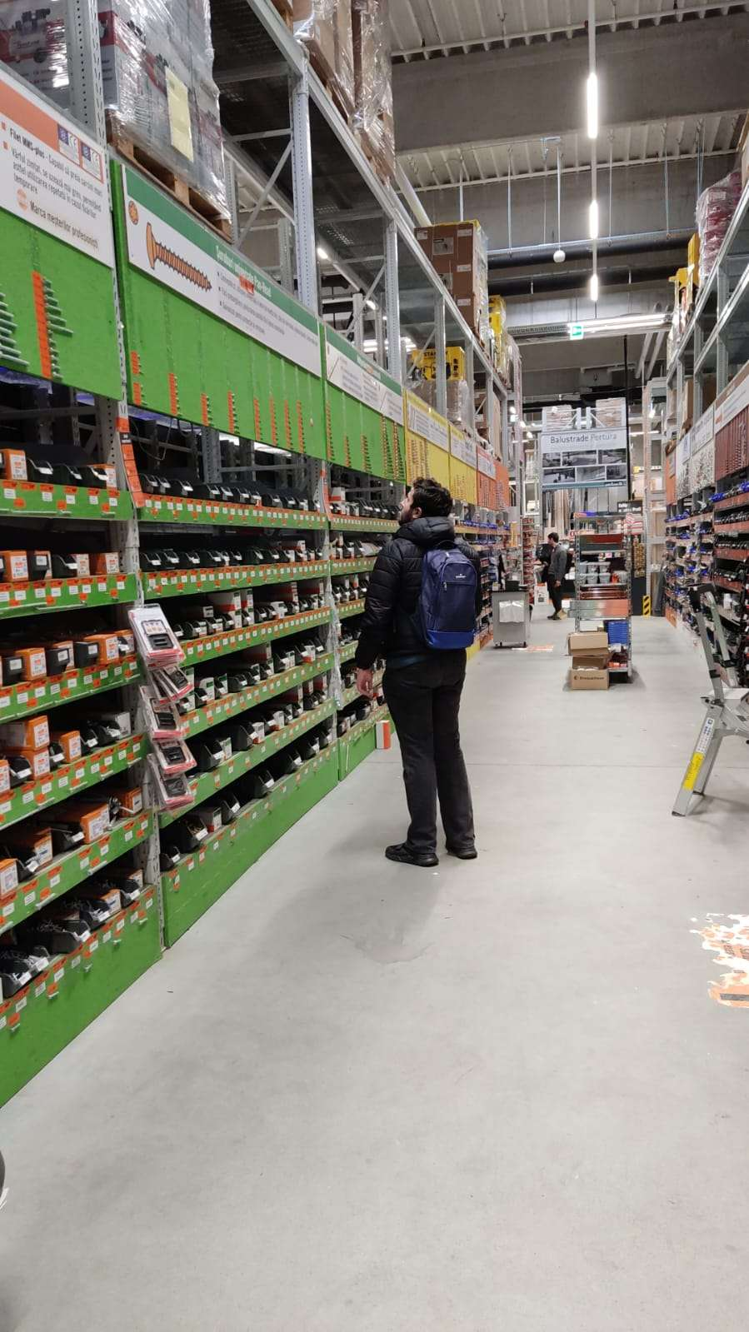
Picture of us hunting the right screws in a tool shop
We have ordered the servo motors recommended by the guide and made a 3D print of the arm, but the screws, they are another story.

Slide 9
04
Implementation
How did we do it?

Slide 10
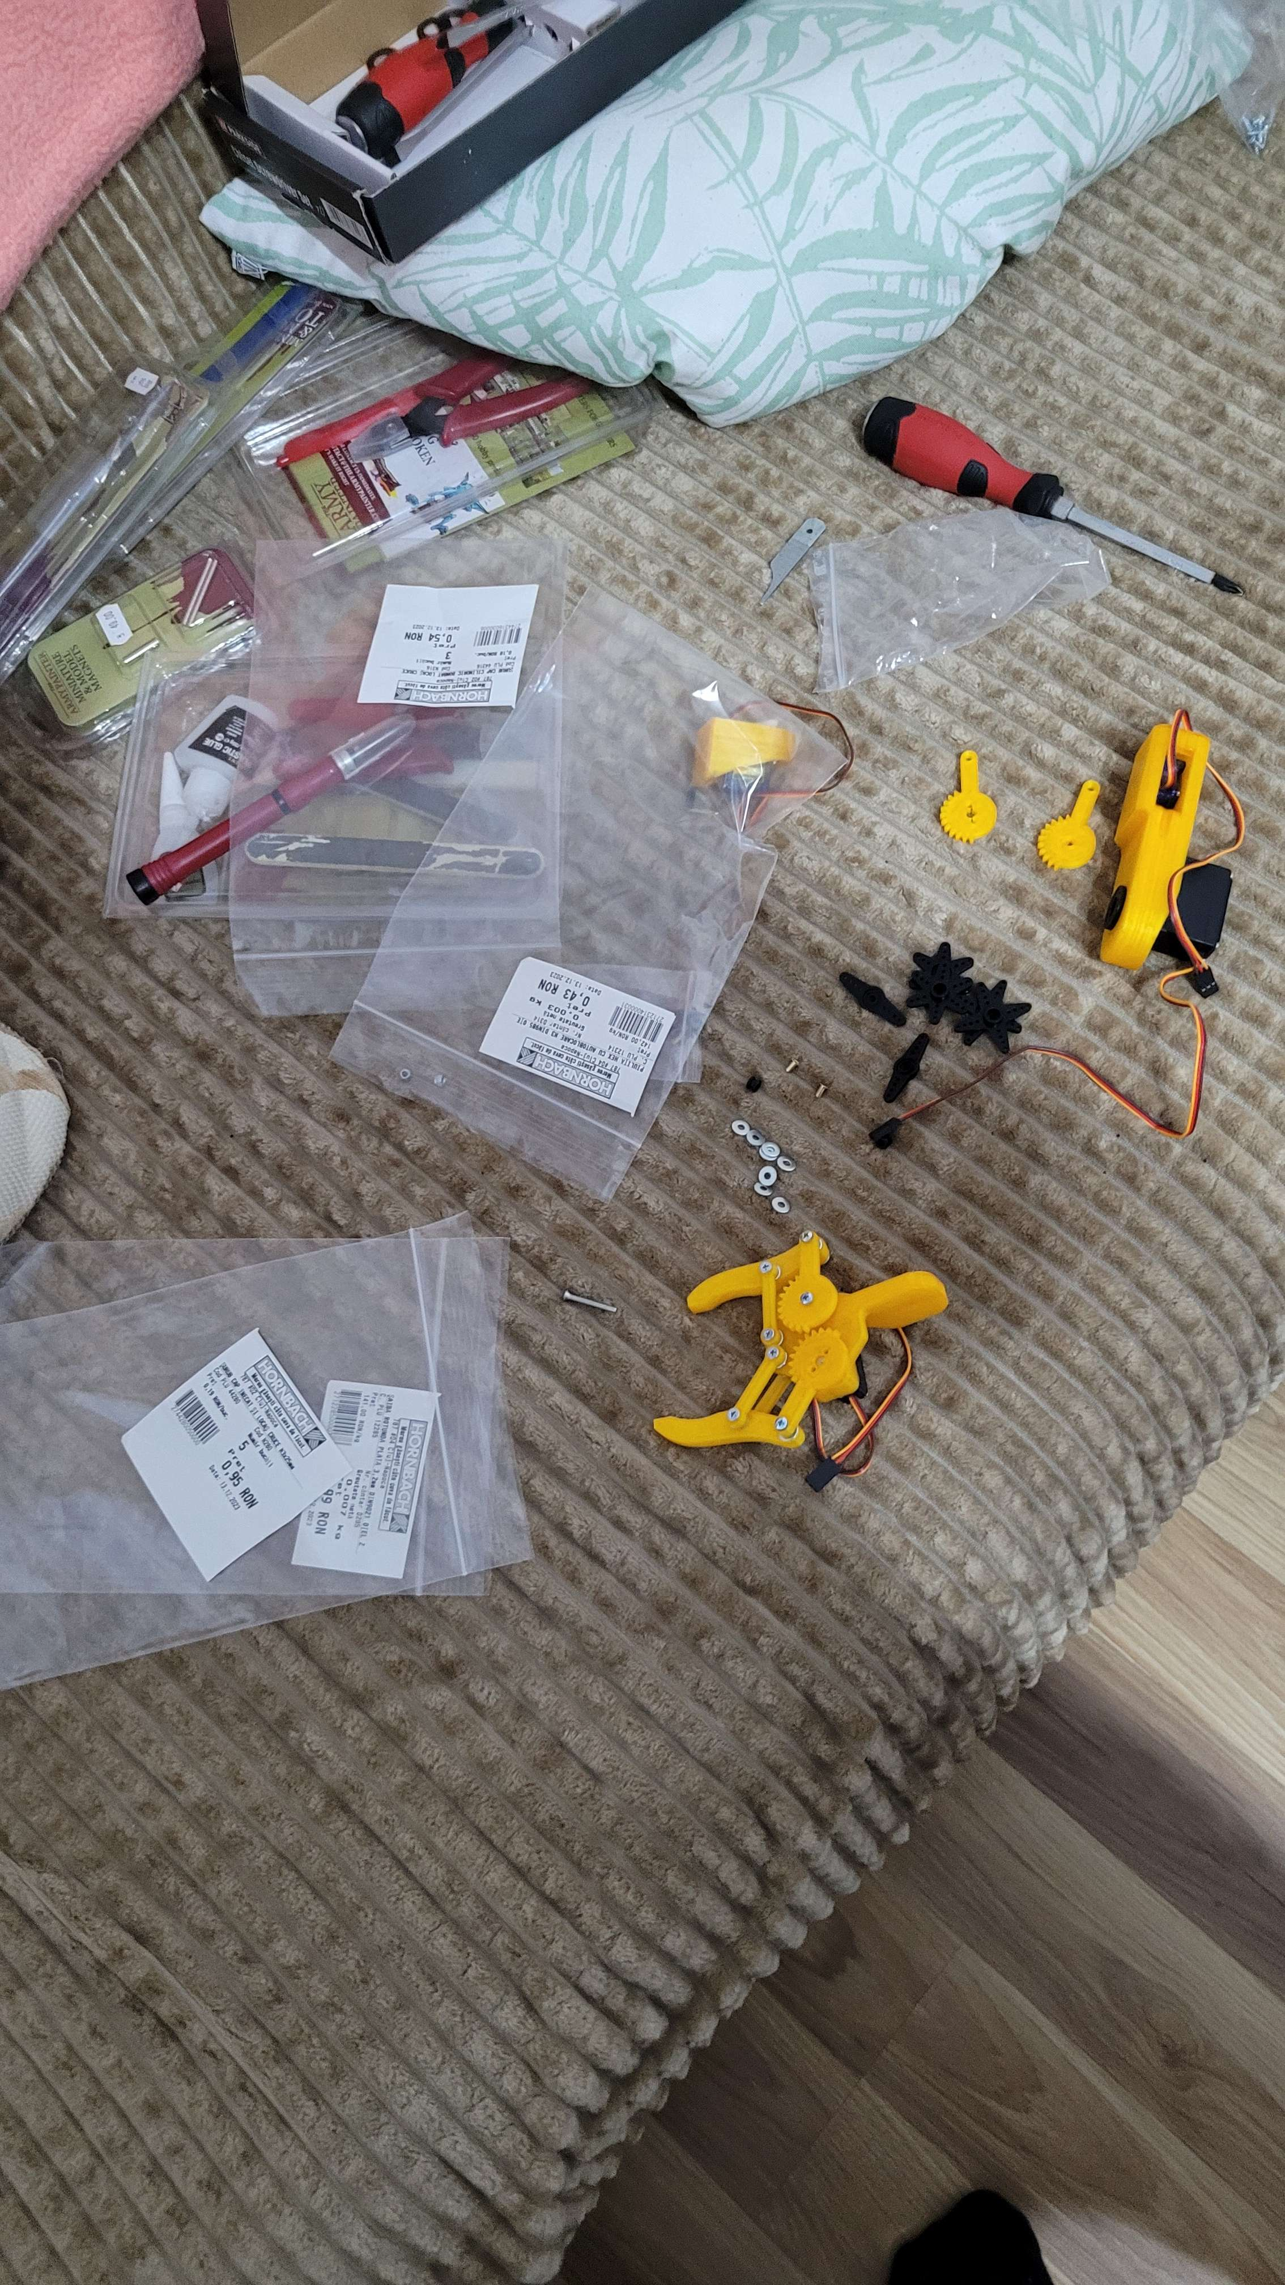
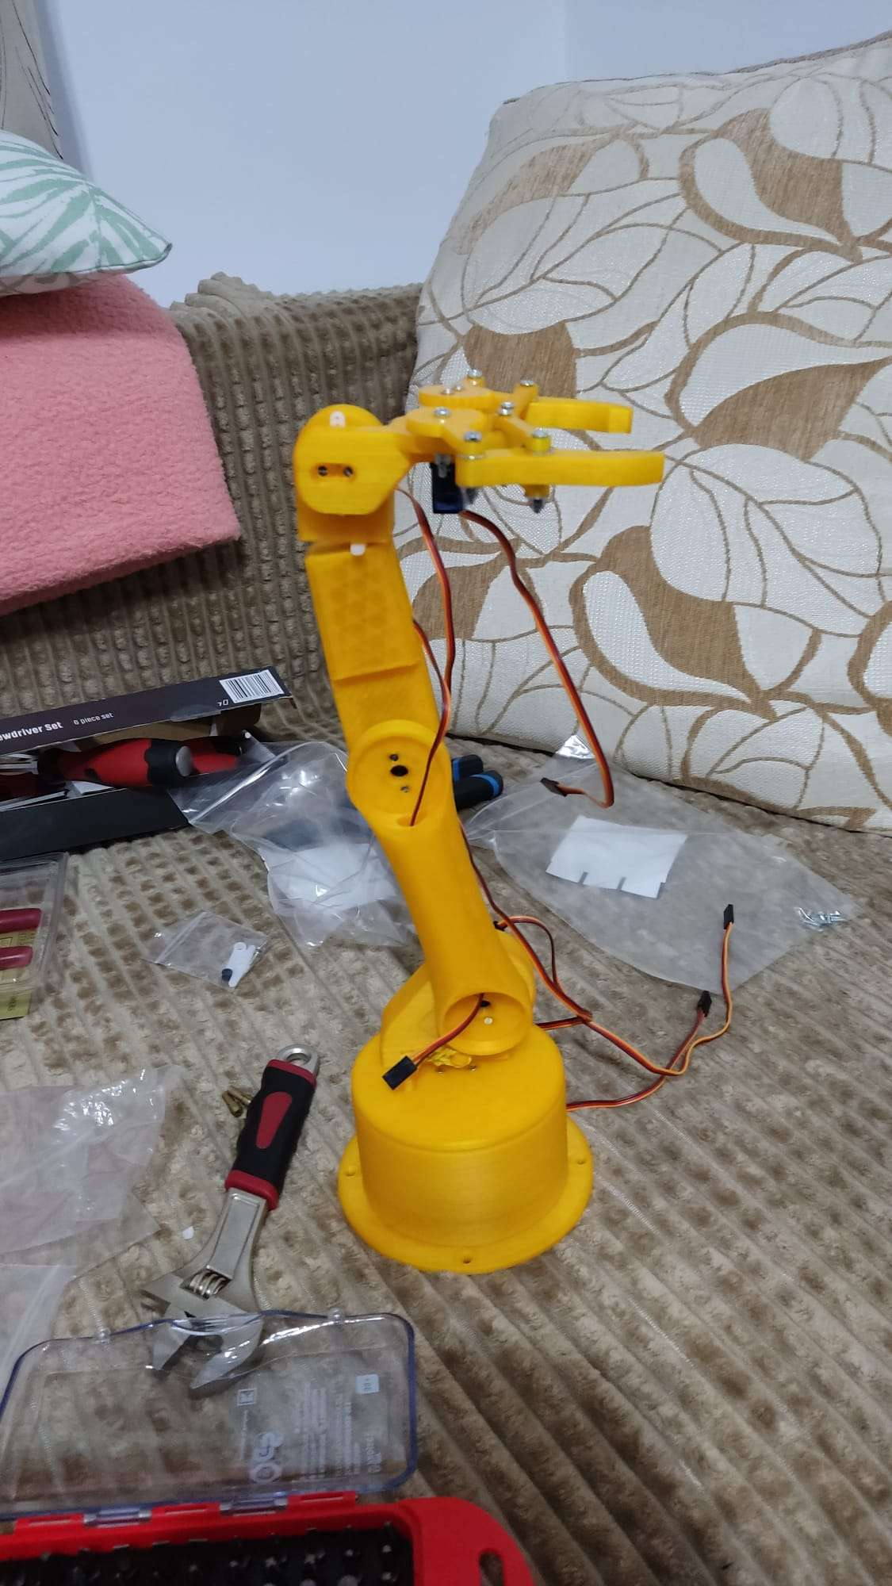
Hardware Assembling
We have assembled the hardware!
After the robot arm was assembled we began developing the app and the Arduino project

Slide 11
05
Testing
Let us see if it works

Slide 12
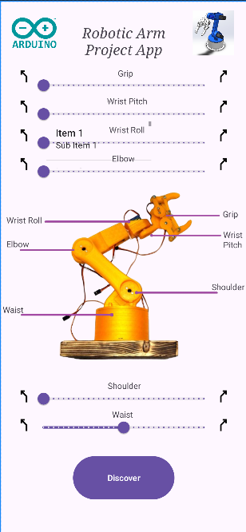
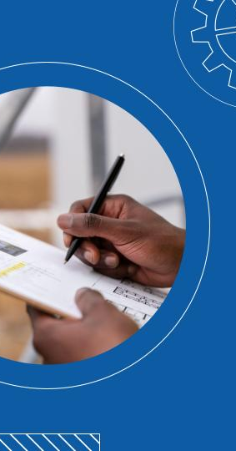
Phone app
We have developed a small application in Android Studio, in order to connect to our Bluetooth module and control the servos

Slide 13
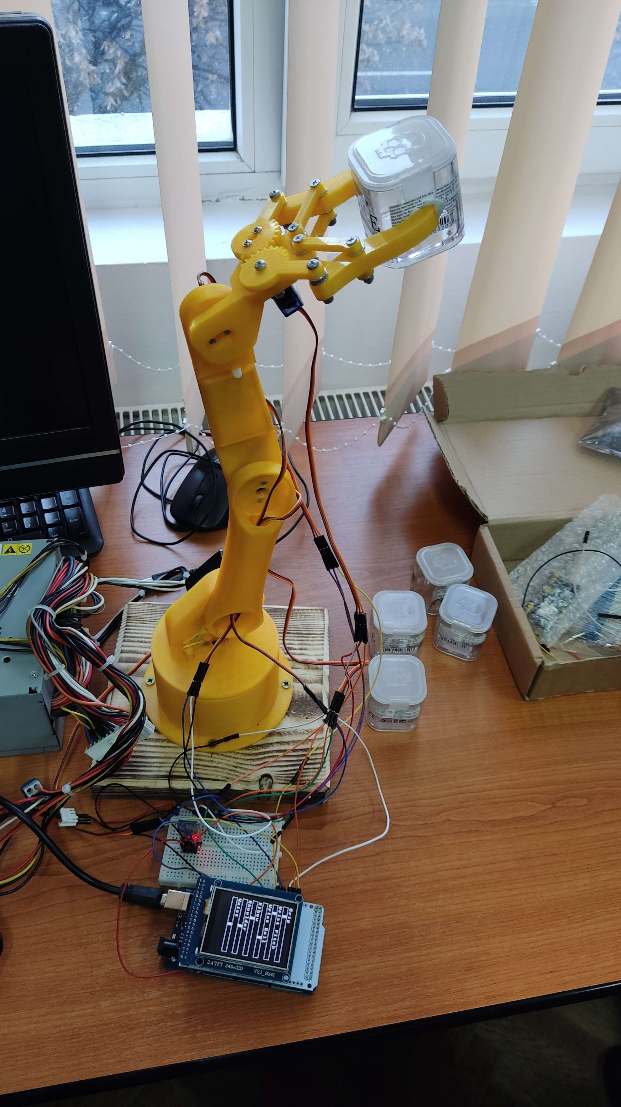
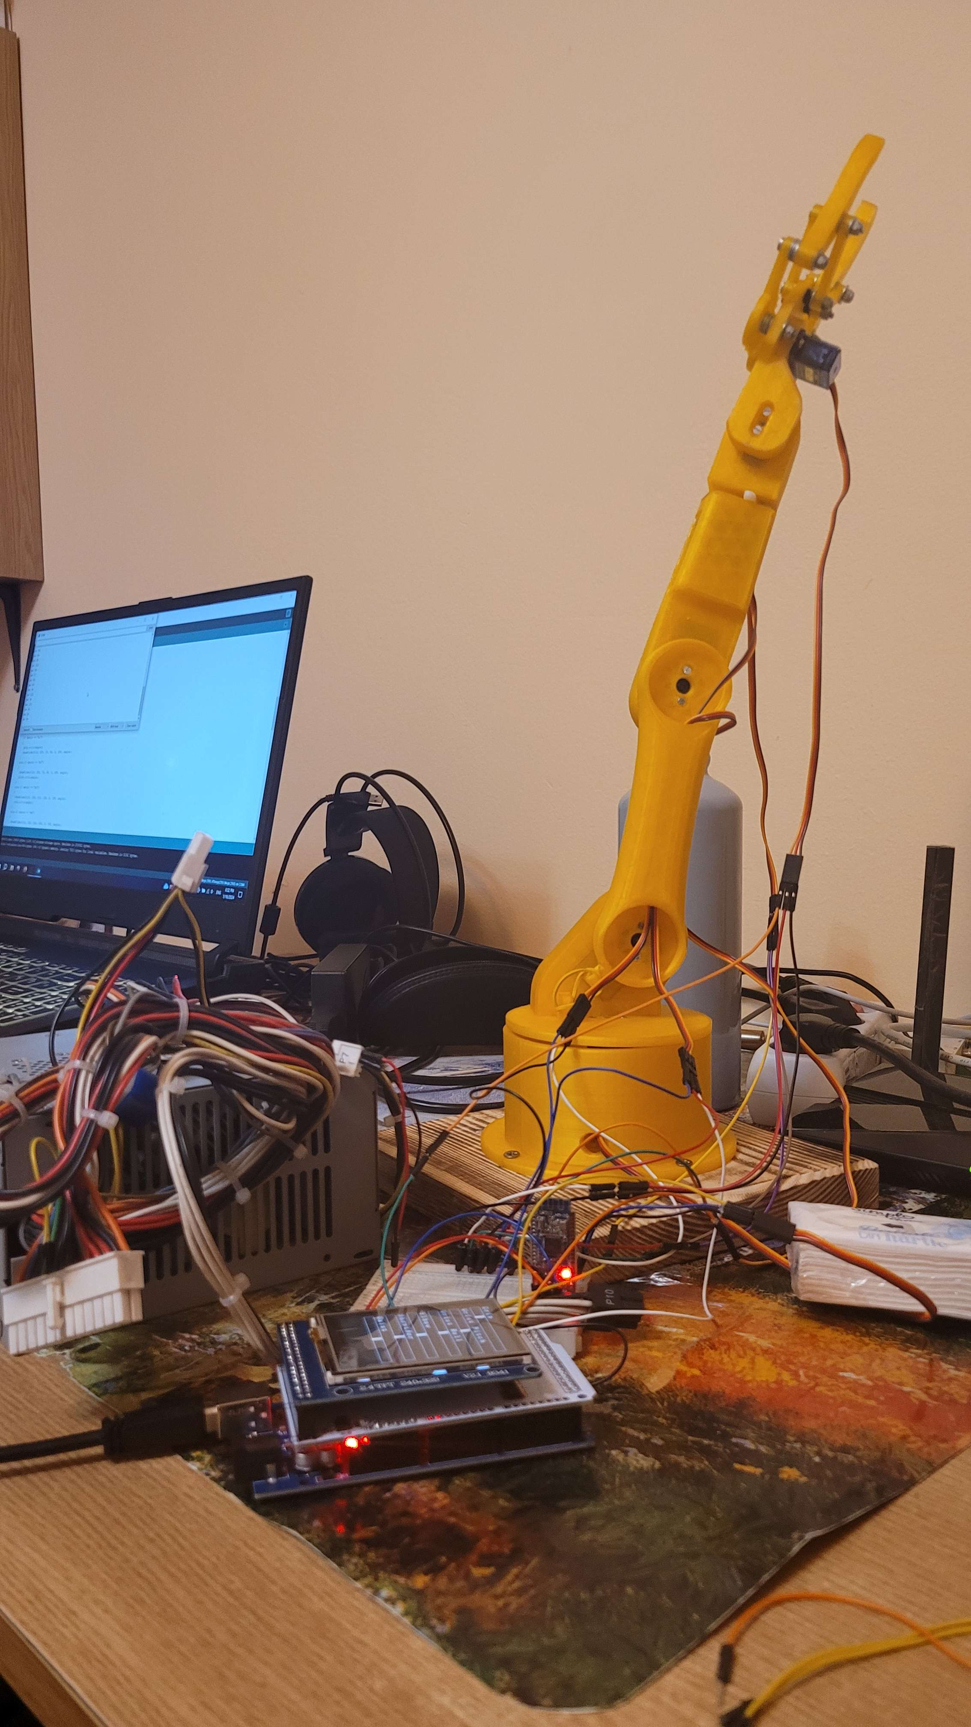
Testing the app on the arm
Testing
We conducted some tests to see the grabbing and control capabilities of the arm

Slide 14
06
References
Our inspiration

Slide 15
Reference Table
DMP Courses and Labs | https://users.utcluj.ro/~rdanescu/teaching_pmp.html
DYI Arduino Robot Arm with Smartphone control | https://howtomechatronics.com/tutorials/arduino/diy-arduino-robot-arm-with-smartphone-control/
Chat GPT | https://chat.openai.com/
Developer Android | https://developer.android.com/
Rinky-Dink Electronics | http://www.rinkydinkelectronics.com/library.php
SlidesGO | https://slidesgo.com/

Slide 16
Thank you!
Where wires meet wonders and ideas spark to life. Until the next byte, keep coding on!

